Slide 1
Welcome to PLP100 Biology of Plant Pathogens
Lecture 1
Why should you take PLP100 “Biology of Plant Pathogens”?
You are interested in plant health / plant pathology / food security
You interested in learning about Infectious Diseases while gaining experience reading and trying to understand scientific literature through peer discussions
You are interested in a career in biological research

Slide 2
Outline
Introductions
Course Logistics
The Science of Learning

Slide 3
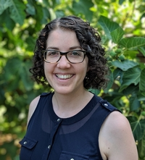
Introductions Prof. Lowe-Power (she/her)
About Me:
Joined UC Davis in Fall 2019
Expert in bacterial biology / bacterial ecology on plants
My goals for the quarter:
Provide learning opportunities for students to strengthen skills: critical thinking, collaboration, communication
Generate enthusiasm for plant pathogens by diving deep into the biology of 8 diverse pathogens
My Hobbies
Cats (Pocket and Blazer)
Maintaining a backyard orchard (10 fruit trees)

Slide 4
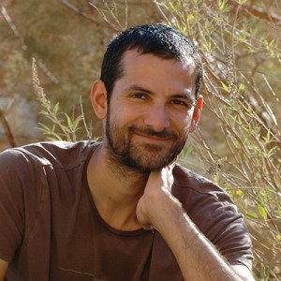
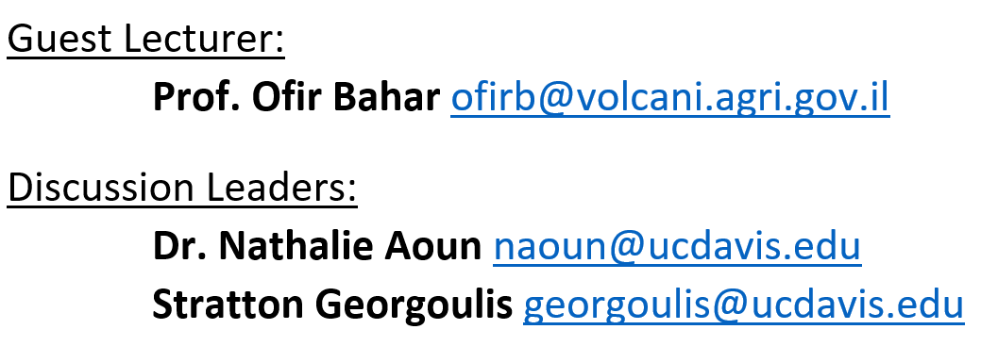
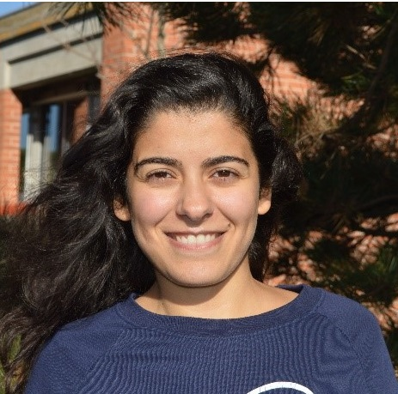
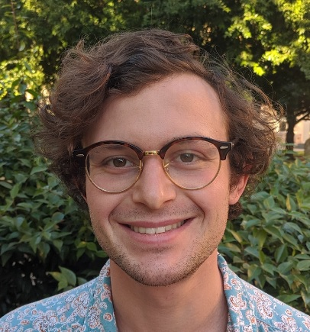
Introductions
Change each time
Expert in insect-transmitted bacterial plant pathogens
Prof. Bahar
Postdoctoral Researcher and Graduate Student Researcher in Lowe-Power lab. Experts on plant immunity and bacterial biology.
Nathalie
Stratton

Slide 5
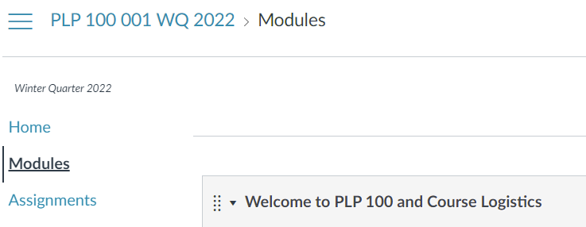
Introduce yourselves on the Class Slack (after lecture, please)
For 3 points extra credit on the final!
Information in the PLP100 Goals and Slack document on Canvas (Welcome/logistics module)

Slide 6
Outline
Introductions
Course Logistics
The Science of Learning

Slide 7
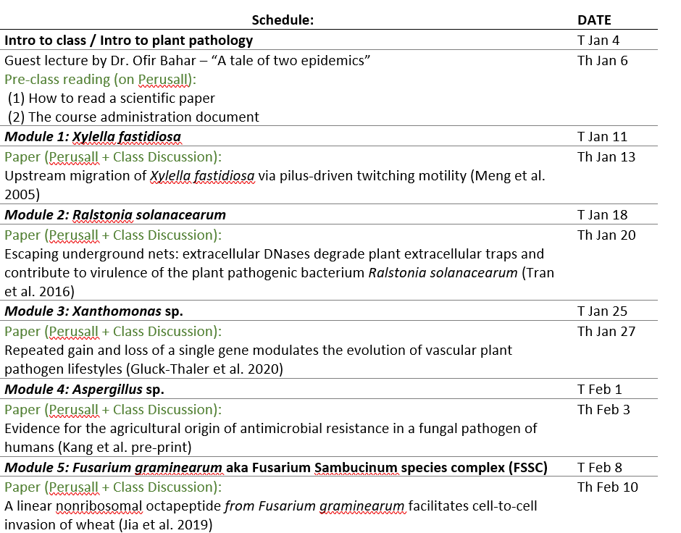
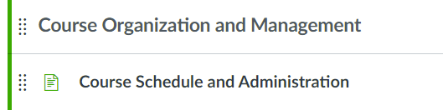
Class Schedule
Change each time
syllabus
Weekly modules that focus on plant pathogens.
3 bacteria
2 fungi
1 oomycete
2 viruses
Tuesdays: Interactive lecture to provide a background on the pathogen
Homework: Read & annotate the assigned scientific paper (Perusall).
Active learning Thursdays: Discuss/Dissect the paper in-person (small group discussions).
Change each time
syllabus
Full schedule is on canvas:

Slide 8
Grading Scheme
30% pre-class readings (via Perusall)
20% participation in Thursday discussions
15% Group Presentations
15% Take-home Final Exam
Same?

Slide 9
Grading Scheme
Same?
40% pre-class readings (via Perusall)
30% participation in discussions
15% Group Presentations
15% Take-home Final Exam

Slide 10
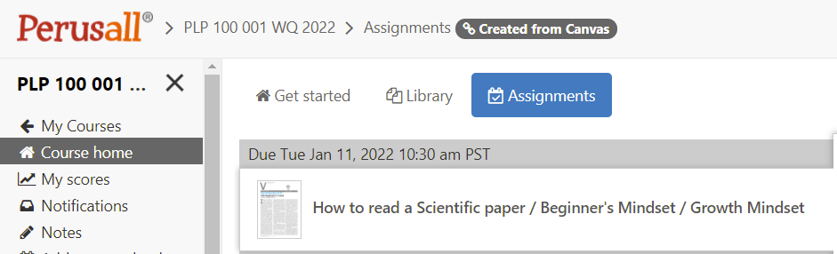
Perusall Assignment #1
Change each time
(date)

Slide 11
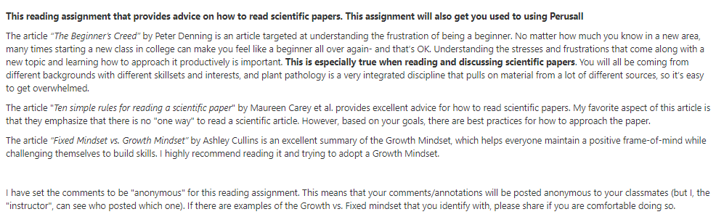
Perusall Assignment #1
Change each time
(date)
Please read
The instructions.
(will be identical for the pathogen papers)

Slide 12
Grading Scheme
40% pre-class readings (via Perusall)
30% participation in discussions
15% Group Presentations
Week 10.
15% Take-home Final Exam
Update with information

Slide 13
Grading Scheme
40% pre-class readings (via Perusall)
30% participation in discussions
15% Group Presentations
15% Take-home Final Exam
Format: Canvas Quiz
Will be based on material from lectures.
Open note. However, all lecture hand-outs will be partial outlines that we will fill out together, so make sure you take notes!
Collaboration with other humans / artificial intelligence is not allowed (Do not use Chegg, texting, etc. for material related to the exam).

Slide 14
Elephant in the room Covid-19
If you have cold, flu-like, or covid-19 symptoms, and/or a “Positive” Covid test (Campus PCR or Rapid Antigen test):
Slack me ASAP to let me know that you cannot attend class in-person.
If possible, please attend class via Zoom.
Delete?

Slide 15
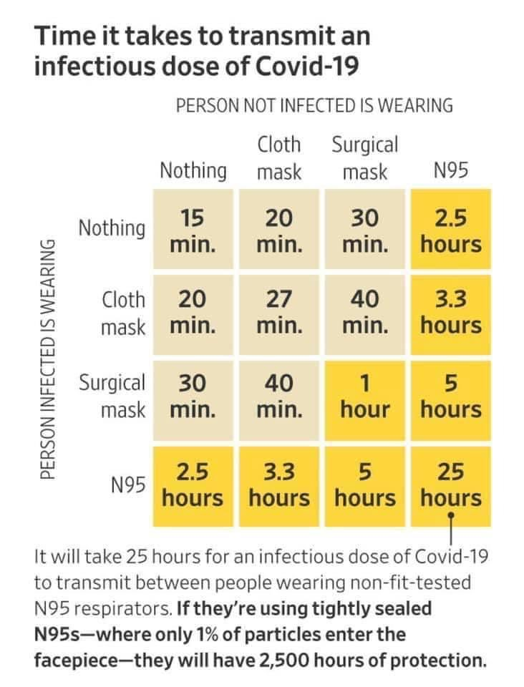
Elephant in the room Covid-19
Data below is regarding a pre-omicron variant (that was less transmissible)
Data shows that N95 or surgical masks should be worn in indoor settings.
Delete?

Slide 16
Course policies: flexibility & mutual respect
Ways I will try to be flexible:
Course design:
Online learning resources (Perusall, Slack, Note outlines on Canvas)
Attempting to teach a few things well vs. teaching many things poorly.
Open-note, online final
I will try to record lecture via Zoom & post on canvas.
I have a checklist, but remind me if I have forgotten.
If you need an accommodation due to chronic or short-term disability, please let me know.

Slide 17
Course policies: flexibility & mutual respect
My requests for you all:
Bring a Growth Mindset & work hard
Help each other (except on the final exam ☺)
Be understanding & flexible to me & your classmates.

Slide 18
Outline
Introductions
Course Logistics
Intro to plant disease

Slide 19
First Perusall reading is Due
(Tues Jan 11)

Slide 20
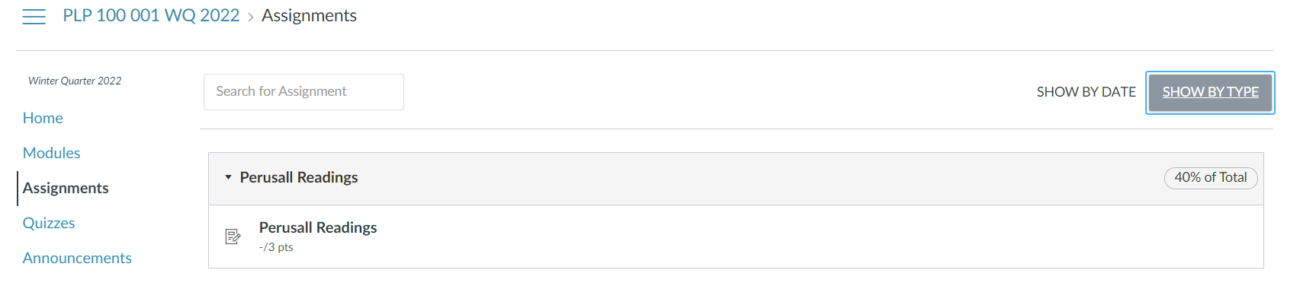
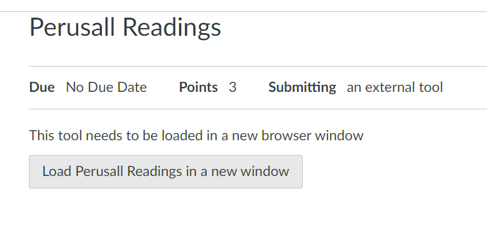



To access readings on Perusall:
1. Go to the Canvas Page > Assignments > Perusall Readings

Slide 21
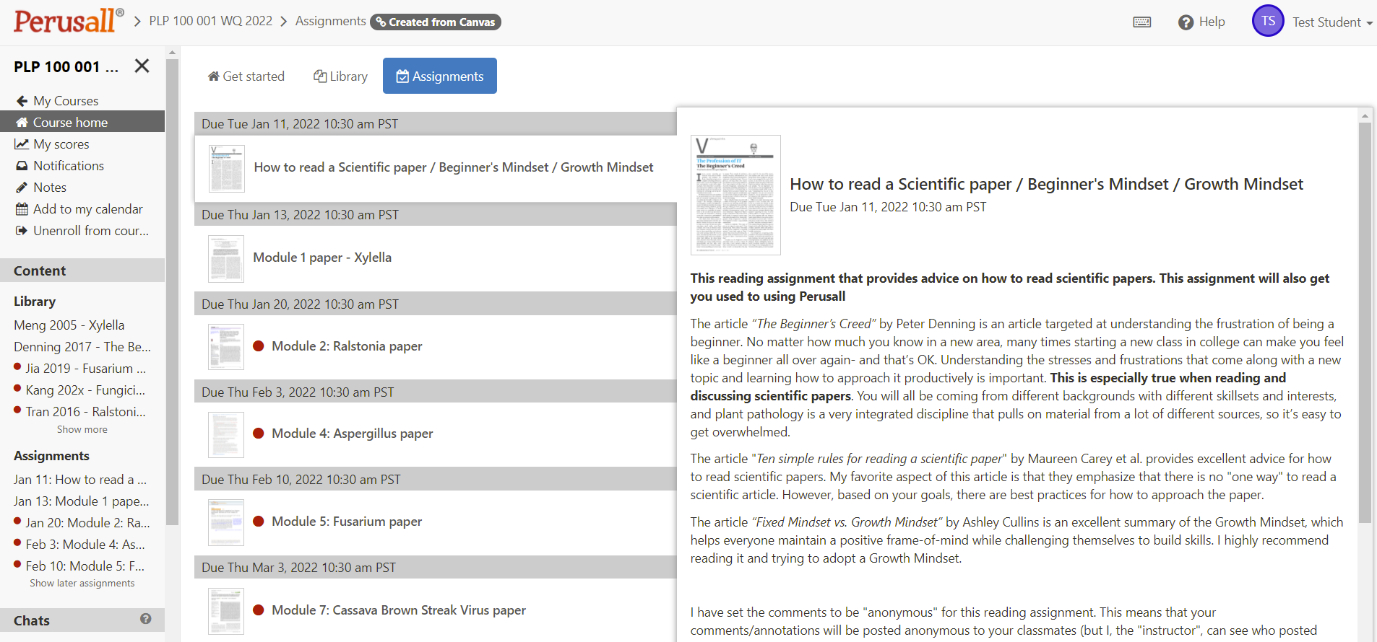





Slide 22
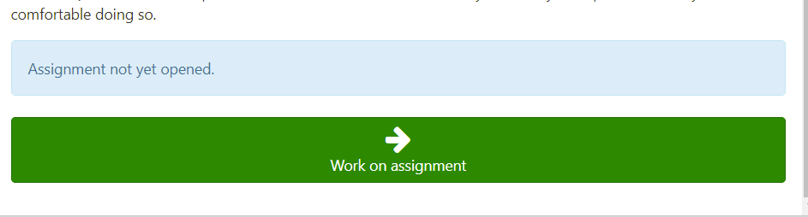
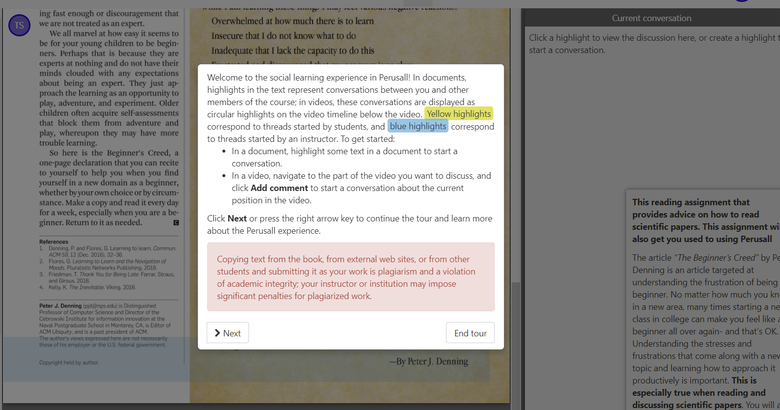
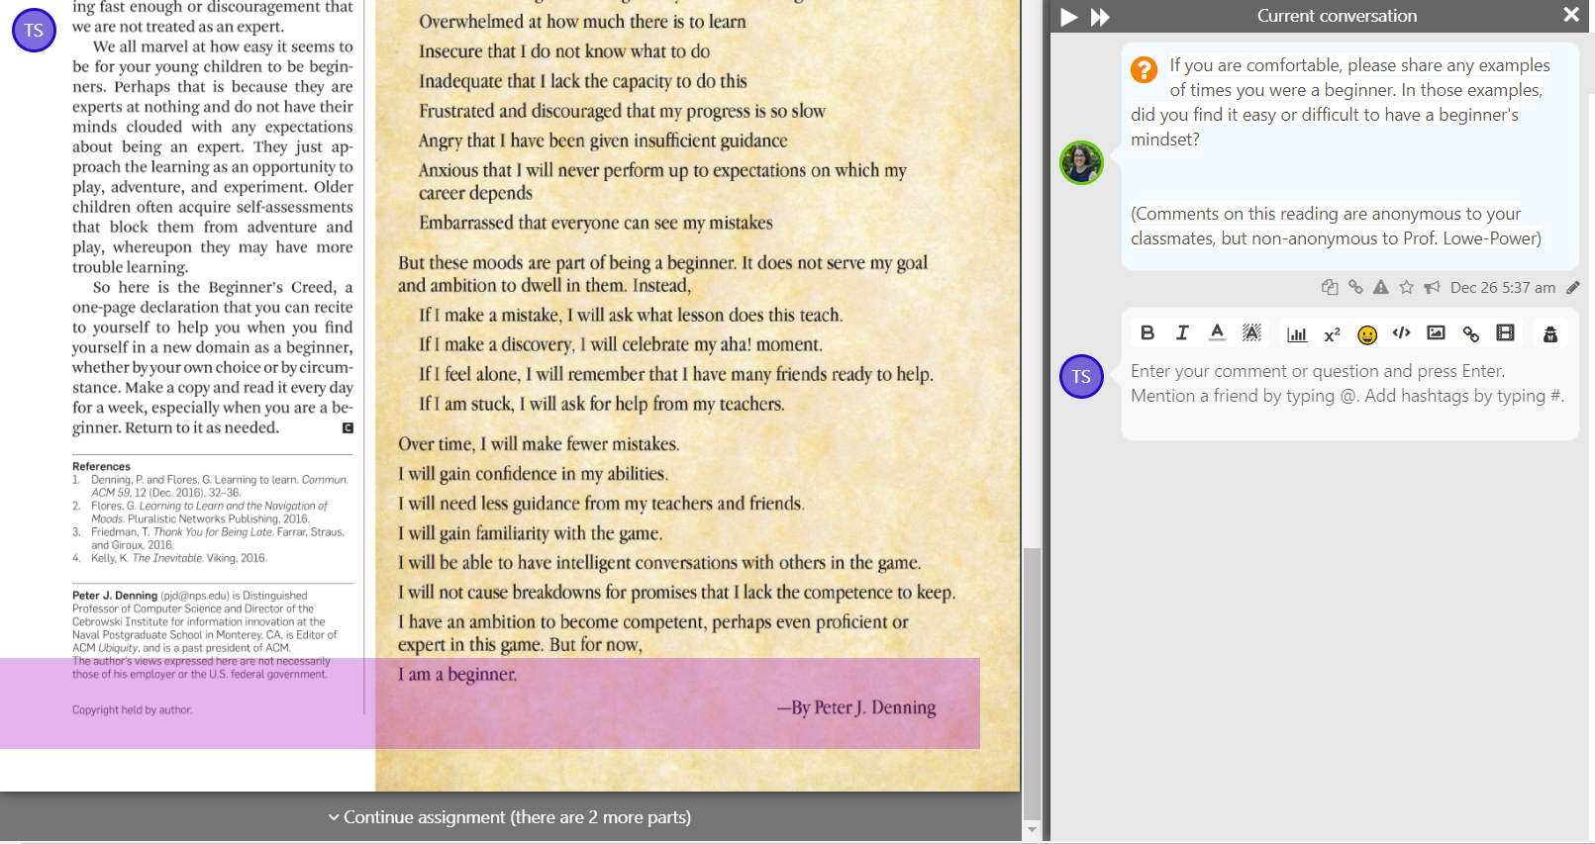
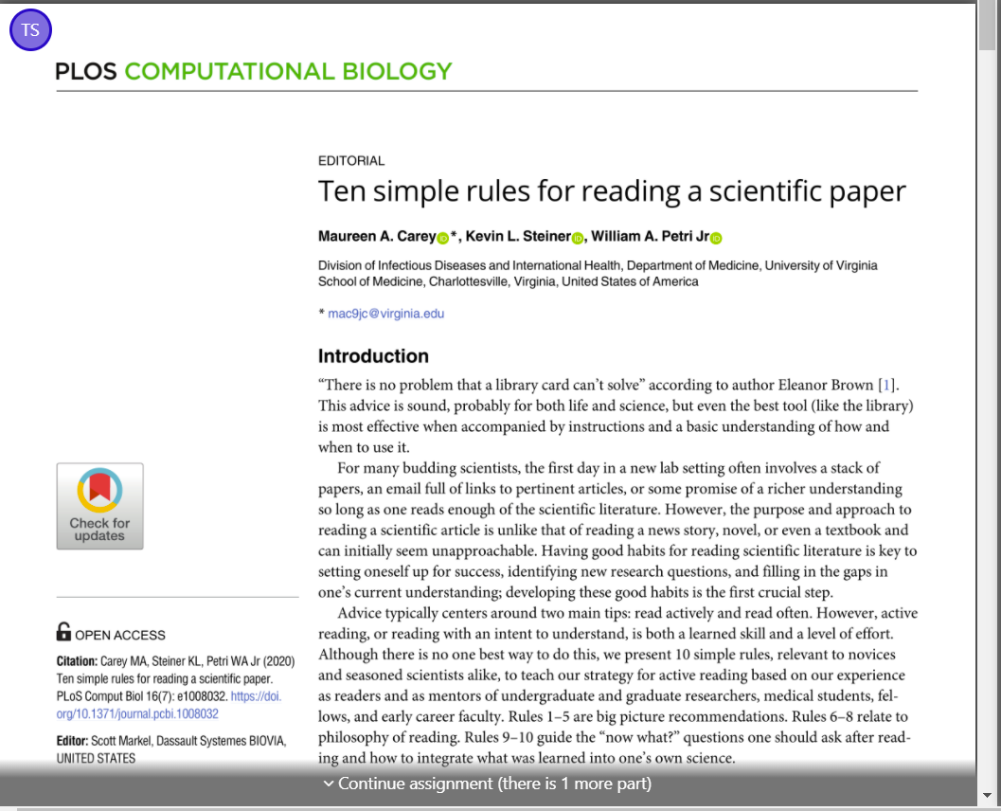
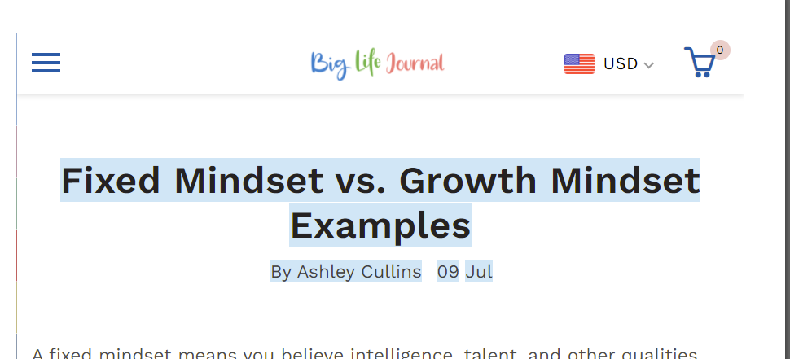




Slide 23
Please try to access the reading today. I could not confirm that Perusall & Canvas are properly linked because I am not a “student” on canvas

Slide 24
Outline
Introductions
Course Logistics
The Science of Learning

Slide 25
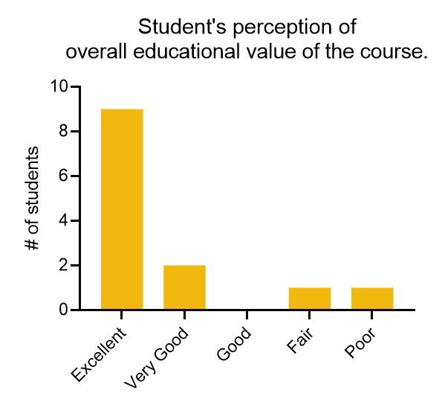
Summary of PLP100 Course evaluations: Bimodal distribution

Slide 26
A lot will be expected from you
Research is in – Active learning
Probably wouldn’t show evaluationss
Why start off negative
Start every class without baggage from prior class.
Here’s my methodology. I find it inspiring to work with students in this mode.
Cheating is difficult to stop. Impossible to stop.
Behavioral economics == write out the integrity statement. Students are more likely to have integrity. Hand write and upload. ← for digital space.
There have been students who have collaborated innapprio

Slide 27
This class is structured so that you & I focus our time, energy, and interactions on behaviors that Promote Learning, Understanding, Student Growth.

Slide 28
Comments from students who thought the class had educational value
"The course was well informed and easy to follow the content.“
"Really thought the structure of the class was a strength and correlated well with the content. The in depth study of a pathogen a week was really interesting and I found it helpful in how I learned.“
"I think the lectures were formatted really well with annotations done on the many figures presented.“
"Using perusall for the homework worked out really well and the discussions were enjoyable as well as informative. The discussions were also good practice in learning how to read and understand figures in articles and presenting said figures as well." "Greatly appreciated the structure and methods of teaching. I found the discussion sections incredibly informative and helpful with the least amount of stress I have ever had. By far one of my favorite classes.“
"Her teaching style was different than other professors because she hand fill in the notes and I think this helped me pay more attention to the content"
"Reading scientific papers was a good approach" "Discussing papers on thursdays and making powerpoint slides to explain to the other groups was very engaging" "The online annotation tools to read papers and see comments and questions from other students made the papers much more digestible. I don't think I reached 100% comprehension of the concepts in all the papers but they definitely pushed my understanding of the pathogens very far compared to what I would have achieved just reading the papers myself. Also, I felt the class had a very welcoming and question-friendly atmosphere." "Excellent professor, made the classroom feel like an open discussion where we could engage with the material and ask questions and improve understanding" "Having weekly discussions was helpful. I like the content, it covered the different pathogen types. The format of the class was nice and I think the workload was fair" "Teaching style worked well for me. Was also communicating with the class frequently outside the classroom, which most of my professors do not do. She was dedicated to the class and the students."

Slide 29
Comments from students who thought the class lacked educational value
“I don't believe the Thursday discussions helped me learn anything. Doing the reading was enough. I wanted to see more content being presented, not the same topic for an entire week.”
“I feel as though we could've dived into the paper and talked as a class instead of presentations on figures. It was very repetitive and it seemed like the whole course was just to practice presentation skill and not actually learn the content we were reading.”
“Calling lecture notes a study guide is not acceptable. Include a more thorough study guide for the final. I feel like I had no guidance for the final and have no idea what is even going to be covered. Students have other classes to study for. It is unreasonable to expect us to simply rewatch every lecture in order to be prepared.”

Slide 30

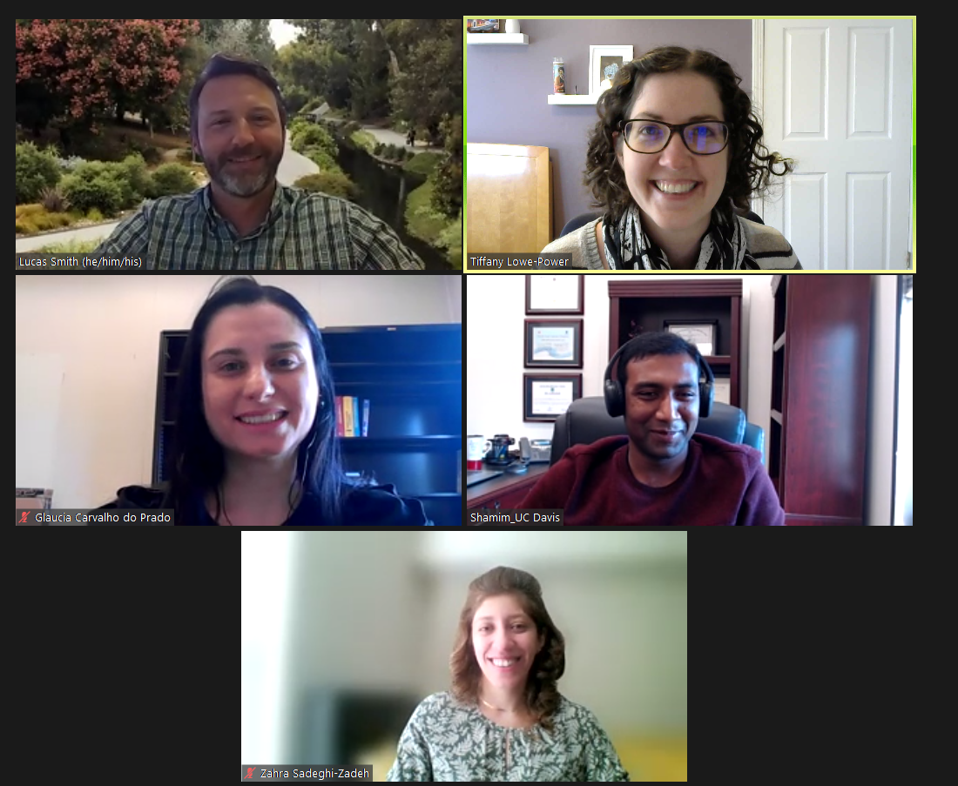

Did you know your professors take classes too?
Engaged Learning and Teaching Community (ELTC)

Slide 31
What factors motivate students to learn?
My goal
Students’ motivation is an interaction
Motivation = x*(Valuation of the Content)* y*(Expectations of Success)* z*(Course Environment)
Motivation
Valuation
Expectations of success
Environment
Oh Noes!

Slide 32
Pedagogy rationale for the Paper Discussions
Purpose of the task (Paper discussions):
Understand how the scientific method is used to uncover new knowledge in biology. This performed by identifying the motivation behind experiments, the approach/methods of the experiment, and results (what the data shows & what it means)
Why is active learning used?
Active learning through teamwork on a defined task is a scientifically-proven way to improve student learning
Narrows the “achievement gap” for students historically excluded and underrepresented in STEM Reference: https://doi.org/10.1073/pnas.1916903117
Improves student learning as measured by Exam Assessments. STEM Reference: https://doi.org/10.1073/pnas.1319030111
Why is this task performed in groups of 3-4?
Science is a social field that thrives with communication and teamwork. Research papers are complex, and they are best understood through a combination of individual effort (pre-class reading) and teamwork (discussion/dissection of the figures).
Students can share their outside knowledge from classes, work, and life experiences
3-4 is an effective group size. Everyone can participate

Slide 33
Pedagogy rationale for the Paper Discussions
Purpose of the task (Paper discussions):
Understand how the scientific method is used to uncover new knowledge in biology. This performed by identifying the motivation behind experiments, the approach/methods of the experiment, and results (what the data shows & what it means)
Why is active learning used?
Active learning through teamwork on a defined task is a scientifically-proven way to improve student learning
Narrows the “achievement gap” for students historically excluded and underrepresented in STEM Reference: https://doi.org/10.1073/pnas.1916903117
Improves student learning as measured by Exam Assessments. STEM Reference: https://doi.org/10.1073/pnas.1319030111
Why is this task performed in groups of 3-4?
Science is a social field that thrives with communication and teamwork. Research papers are complex, and they are best understood through a combination of individual effort (pre-class reading) and teamwork (discussion/dissection of the figures).
Students can share their outside knowledge from classes, work, and life experiences
3-4 is an effective group size. Everyone can participate

Slide 34
Pedagogy rationale for the Paper Discussions
How will you be evaluated?
The weekly discussions are “Formative Assessments”.
That means they are process-oriented and the instructor will monitor and provide timely feedback.
The presentations are only graded as +/- Participation, so they provide an opportunity for student growth / learning / skill development without the threat of a penalty.
The weekly discussion presentation will prepare students for the “Partner Presentations” (week 10)
The verbal and visual communication in the Partner Presentations will be assessed based on a rubric

Slide 35



How does students’ prior knowledge affect their learning?
When: Accurate,
Sufficient,
Activated
Prior knowledge
Learning
When: Inaccurate,
Insufficient,
Inactive

Slide 36
How I try to leverage your knowledge
Connecting Knowledge
Beginning of Lectures:
Share what you know about the topic.
Explicitly Link Course Material to
Other Biology Fields
Earlier lectures
Remediate Insufficient Prerequisite Knowledge
Intro Week’s reading—How to read a Scientific Paper
Identify Discipline-Specific Conventions
Ask Students to Justify Their Reasoning

Slide 37
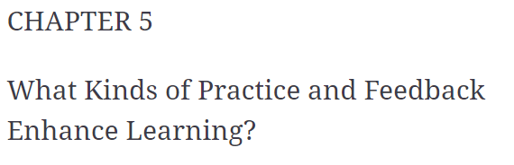
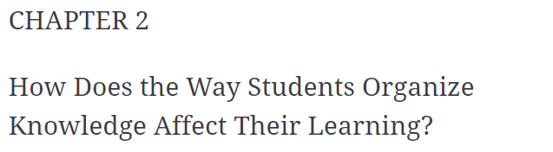
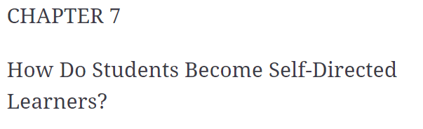
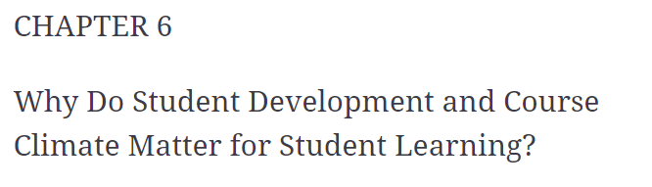
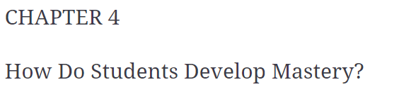
Did you know your professors take classes too?

